Slide 1
Date Night App
Terence Dawson, Paul Frazier

Slide 2
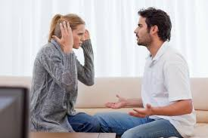
Have you ever been annoyed that you can’t figure out what to do for a date night?

Slide 3
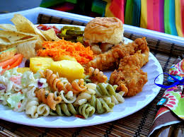

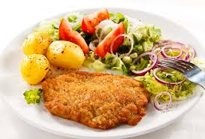
Or even for something simple as what to eat for dinner?

Slide 4
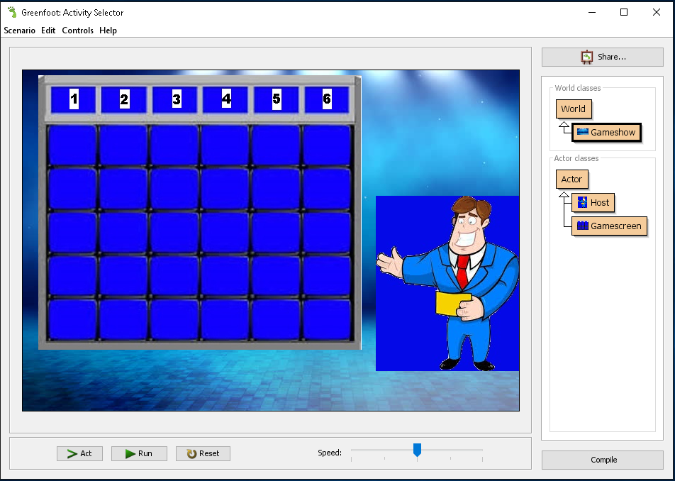
Let the Date Night app do the work for you!

Slide 5
Key Features
Interactive
Sound Effects
6 Different Categories and 30 selections to choose from

